Slide 1
Digital Media Technology Week 9: SQL 2

Slide 2
Assignment 3 Due 18 December
Take Home Exam Due 25 January

Slide 3
Writing queries
Which table(s) contains the information that you need? (FROM)
All the records? (WHERE)
One answer for the entire table, or different answers for different types of records? Actual contents or statistical information? (GROUP BY)
Which columns do you want to see? (SELECT)
Do you want to see duplicate values or are you only interested in different values? (DISTINCT)
Do the records in the result set need to be sorted in any particular way? (ORDER BY)

Slide 4
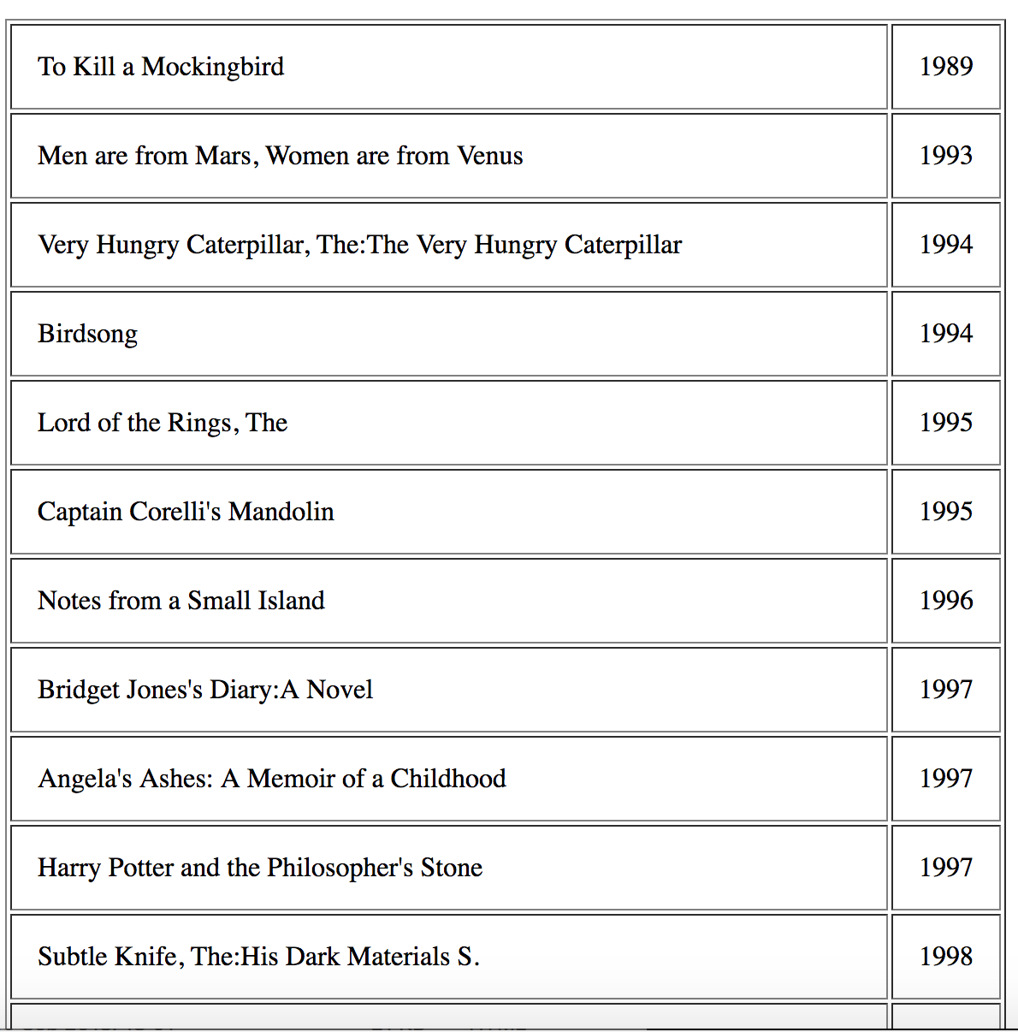
SELECT TITLE, YEAR FROM BESTSELLER ORDER BY YEAR ;

Slide 5
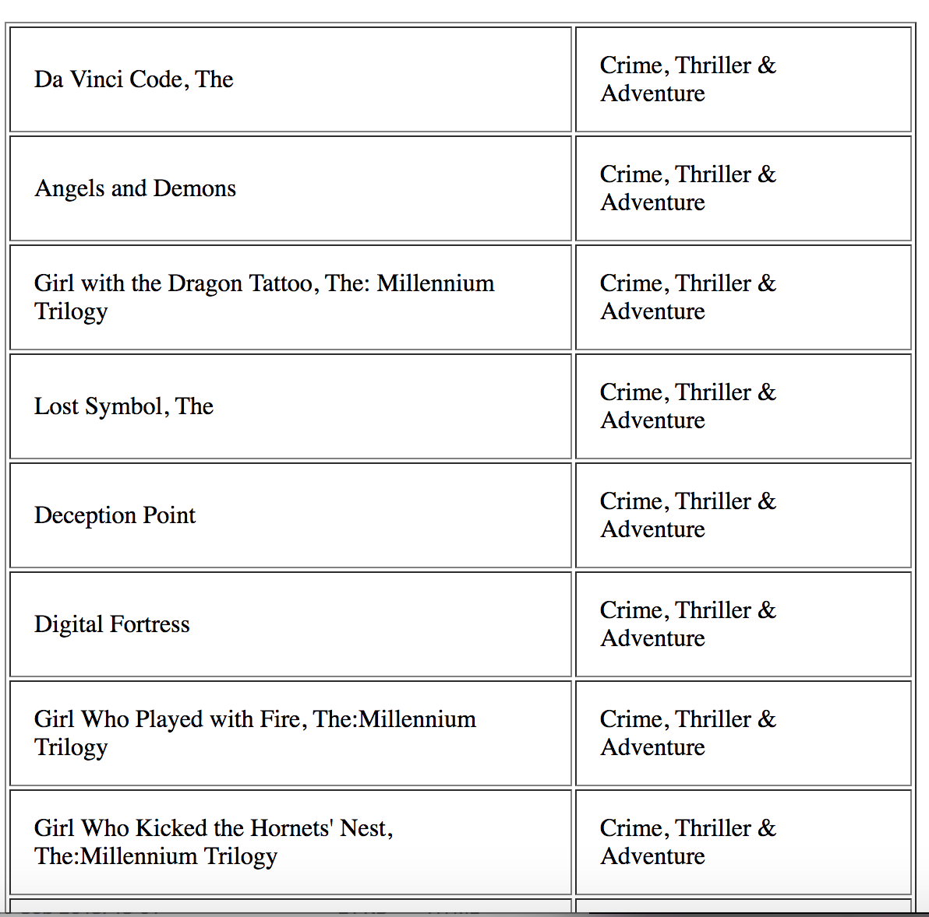
SELECT TITLE, G.GENRE FROM BESTSELLER B JOIN GENRE G ON B.Genre = G.Genre_ID

Slide 6
Joining tables
Two methods:
After “FROM”: Mention the two tables that you want to join; and after “WHERE”; Explain HOW the tables are related (PK = FK)
OR mention the first table after “FROM” and the second table after “JOIN”; Explain how the two tables are related after “ON”
INNER JOIN May result in a loss of information

Slide 7
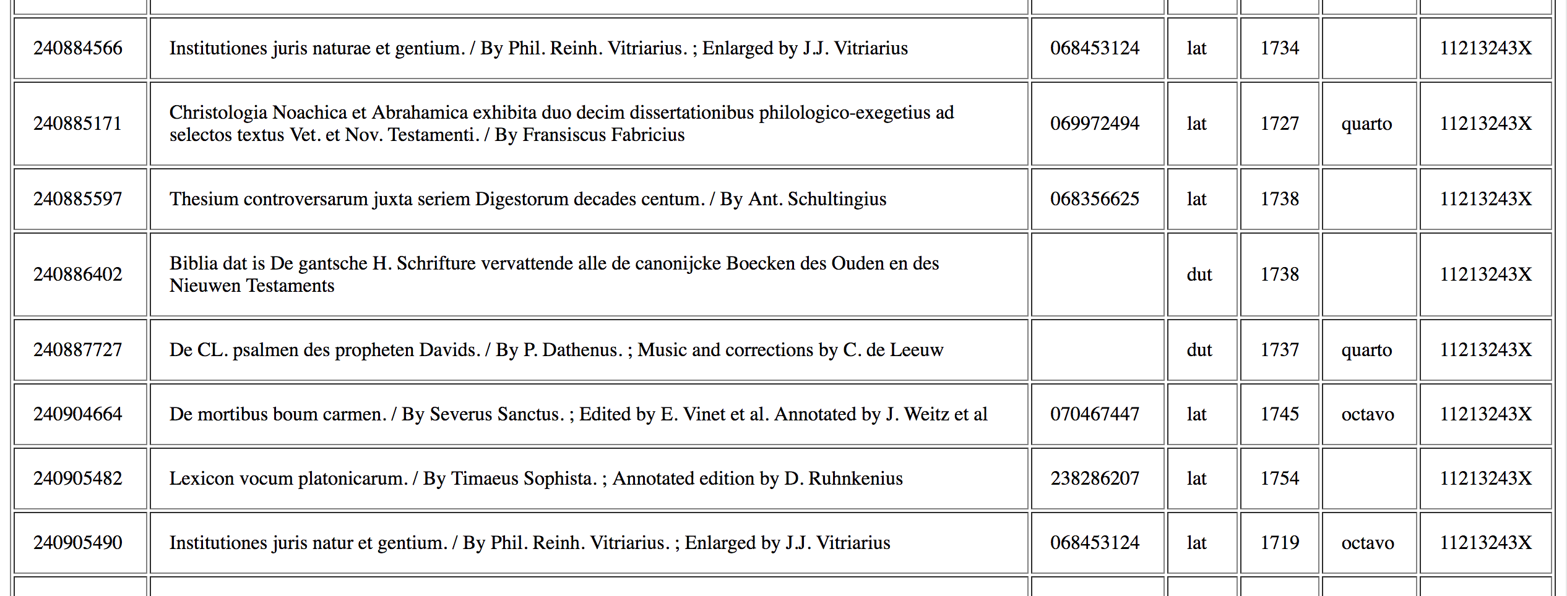
Foreign key column may contain empty cells

Slide 8
Left Join
SELECT TITLE , NAME_FIRST , NAME_LAST
FROM BOOK
LEFT JOIN PERSON
ON BOOK.AUTHOR = PERSON.P_ID

Slide 9
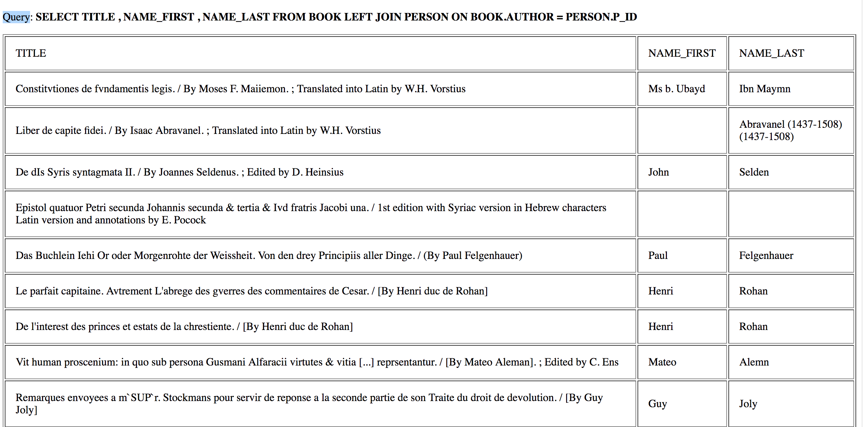

Slide 10
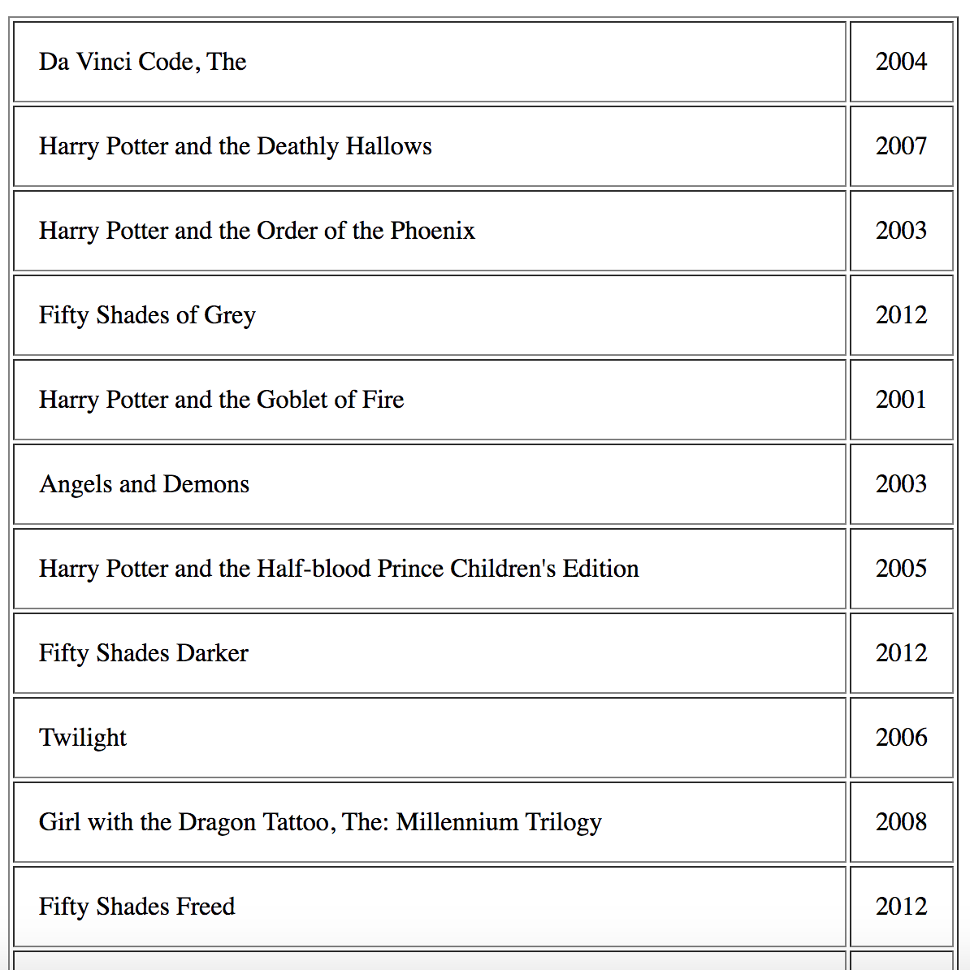
SELECT TITLE, YEAR FROM BESTSELLER WHERE YEAR > 2000

Slide 11
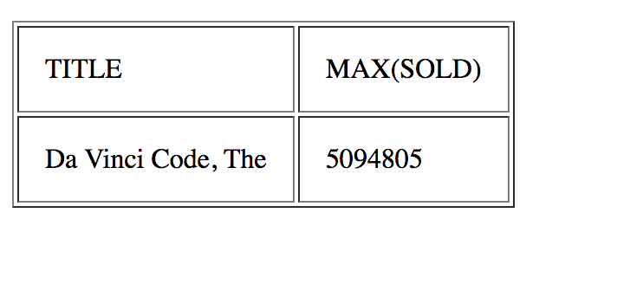
Query:
SELECT TITLE , MAX(SOLD)
FROM BESTSELLER
Result:

Slide 12
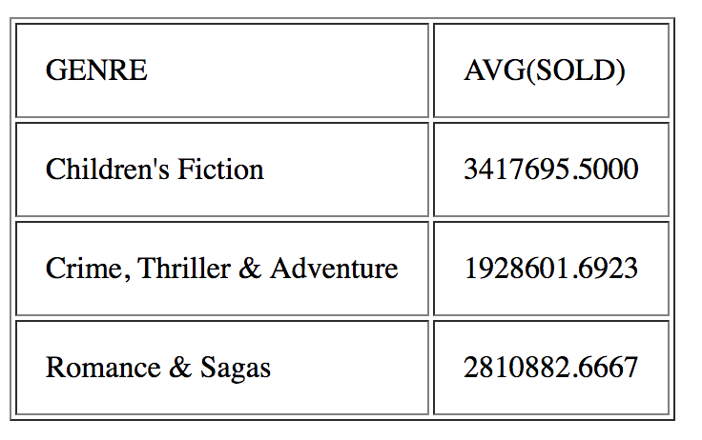
SELECT G.GENRE , AVG(SOLD)
FROM BESTSELLER B
JOIN GENRE G
ON B.GENRE = G.GENRE_ID
GROUP BY G.GENRE
HAVING AVG(SOLD) > 1500000

Slide 13
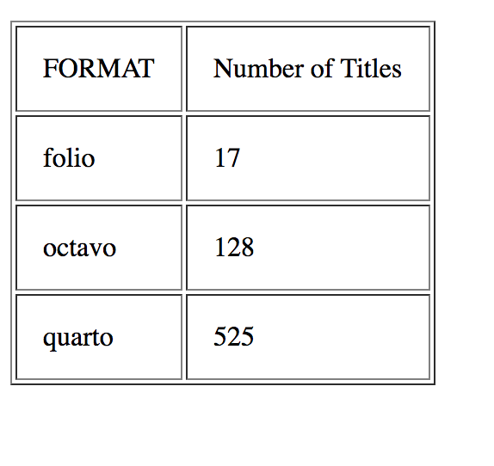
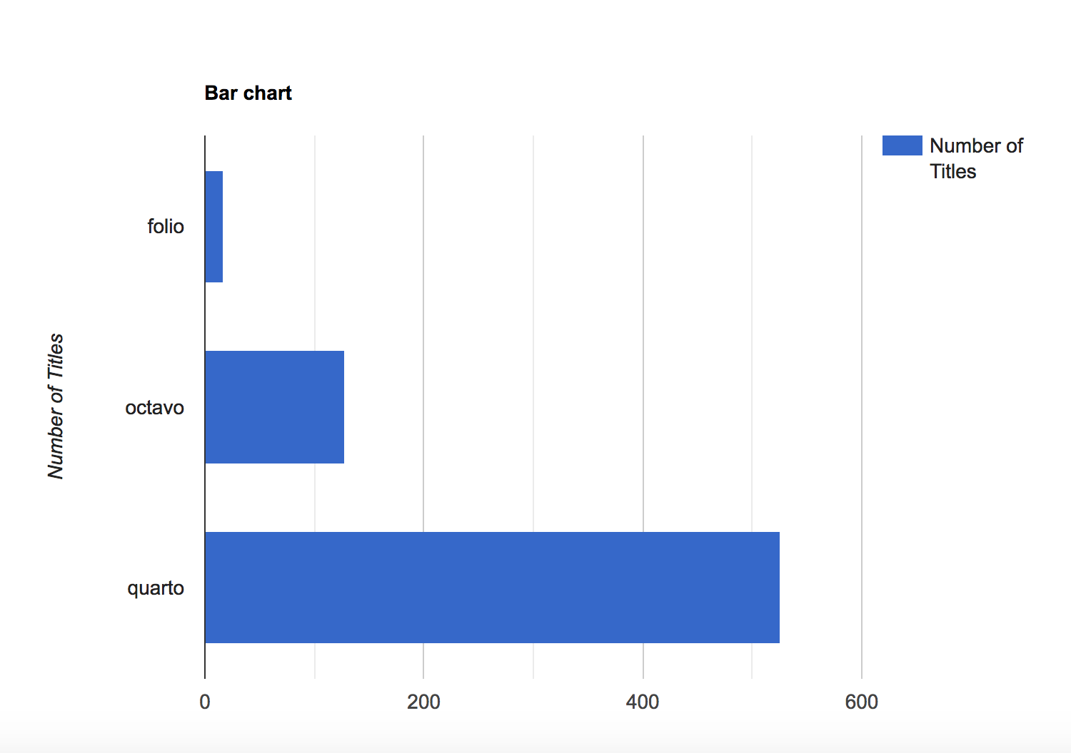
Visualisation
Based on Google Charts

Slide 14
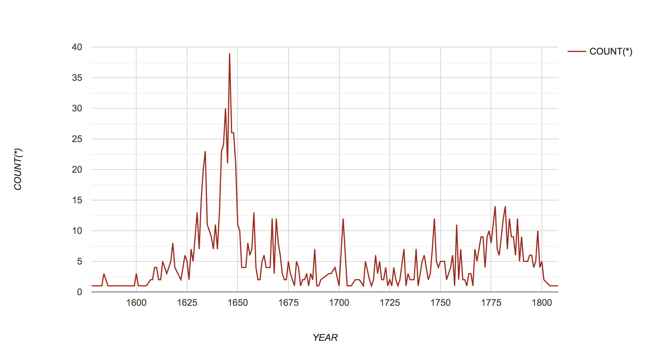
Line chart
SELECT YEAR , COUNT(*) FROM BOOK B LEFT JOIN CLASSIFICATION C ON B.B_ID = C.Book LEFT JOIN TOPIC T ON C.Topic = T.T_ID WHERE T.Term LIKE '%Theology%’ GROUP BY YEAR

Slide 15
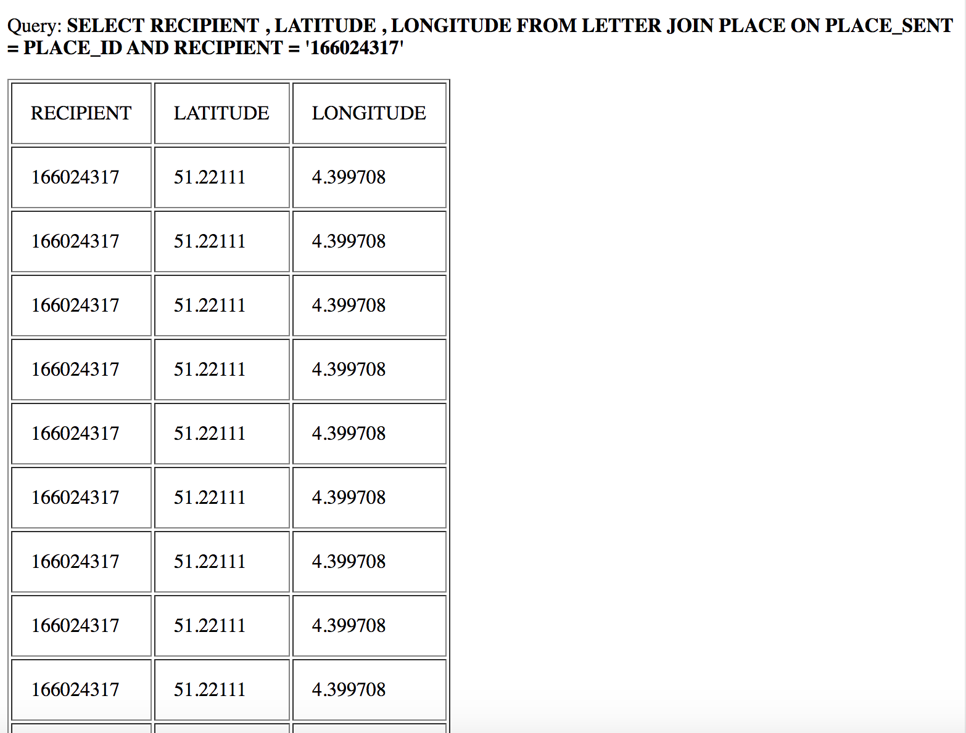
Geographic data

Slide 16
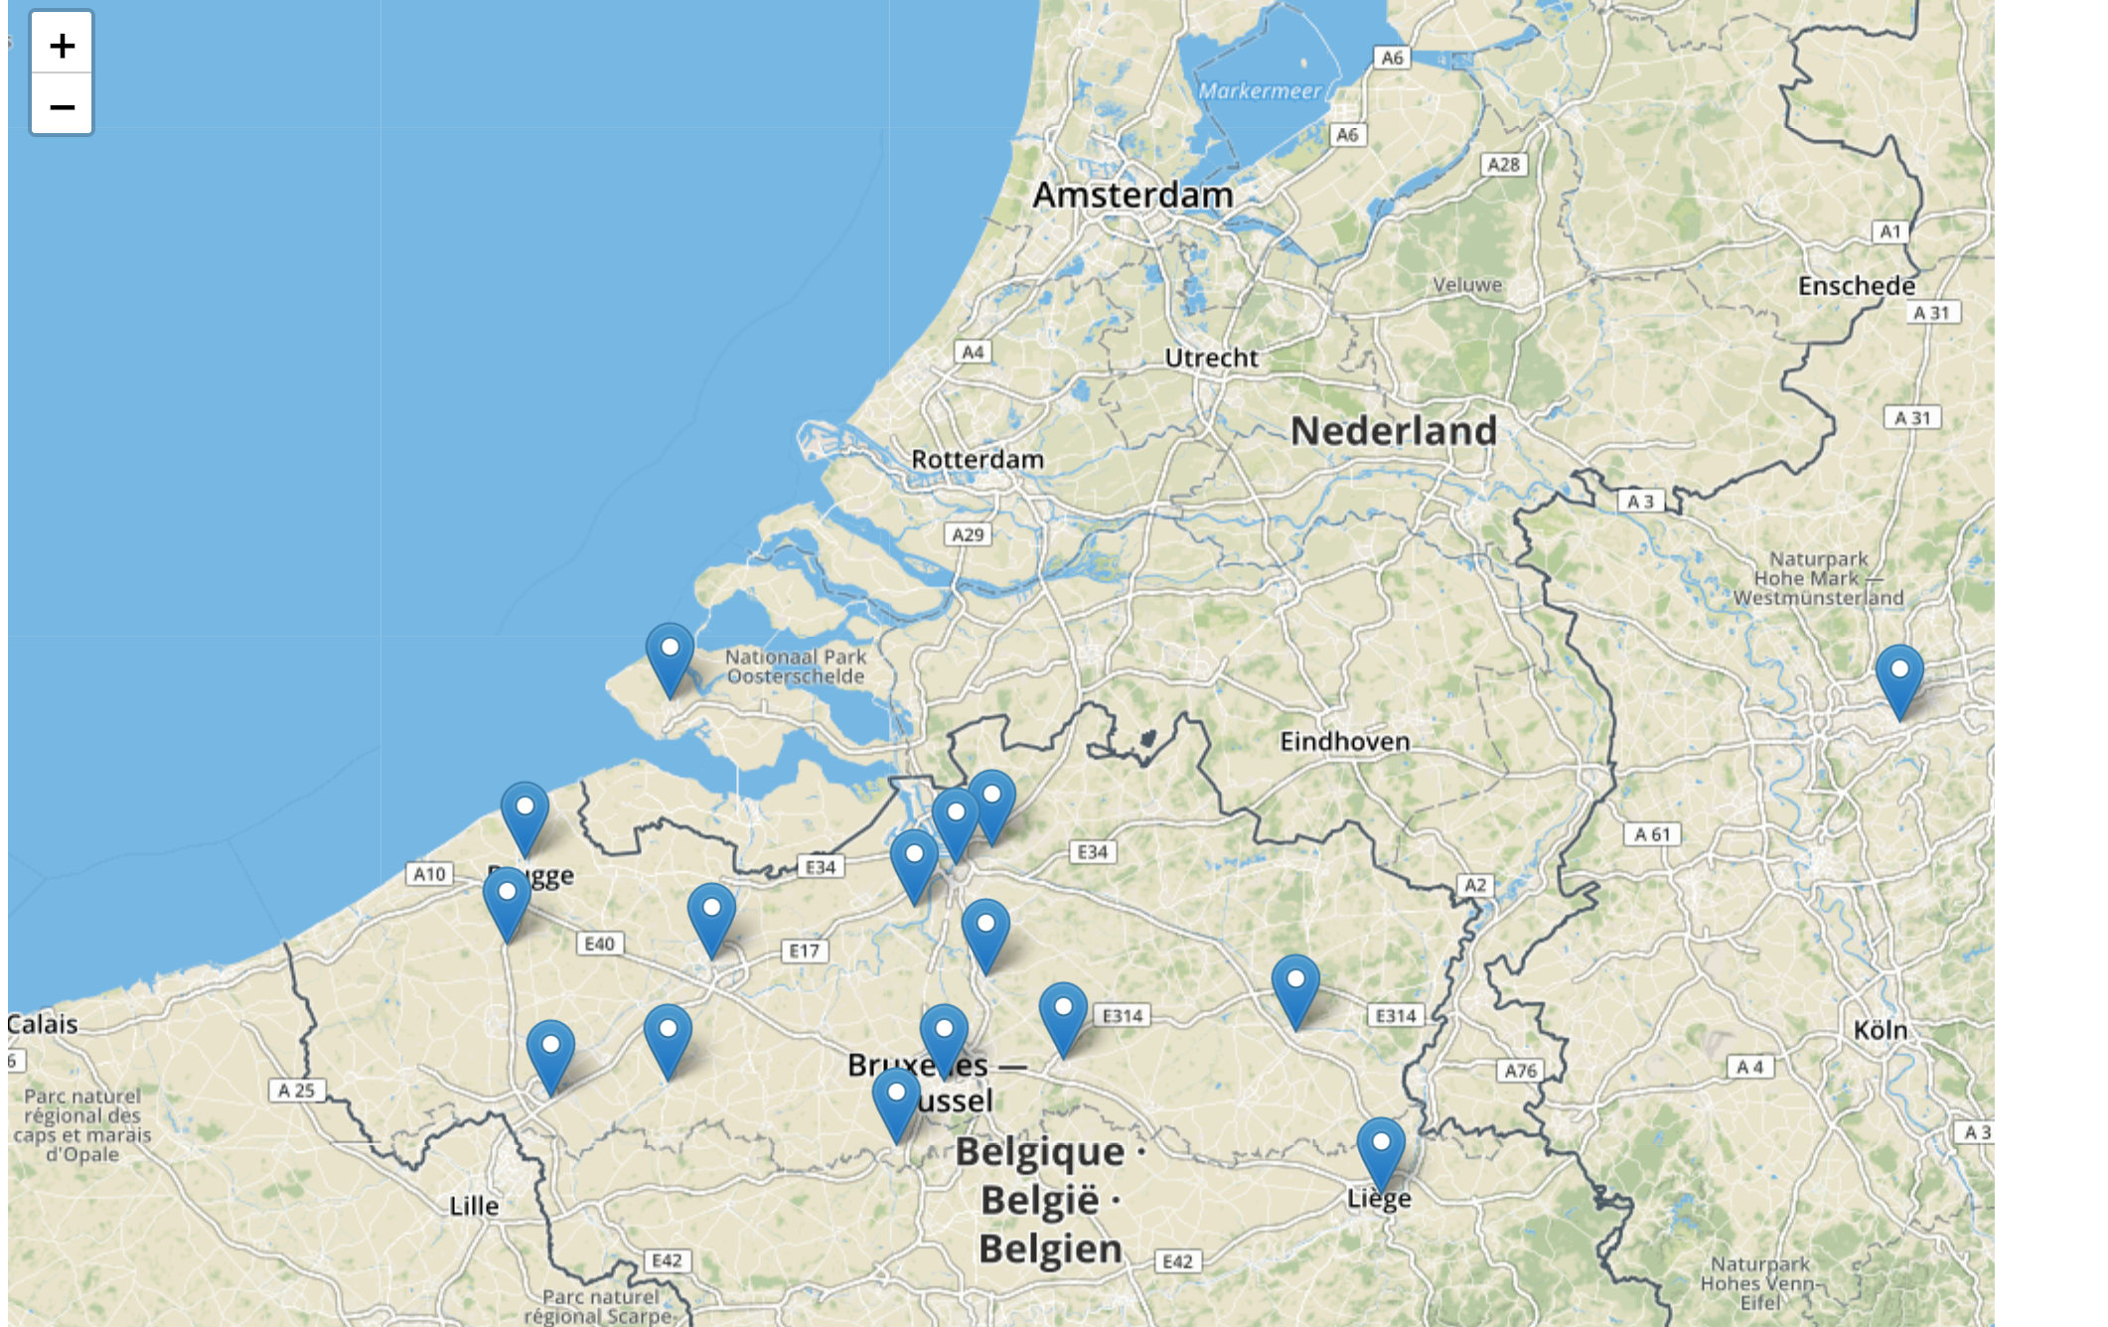

Slide 17
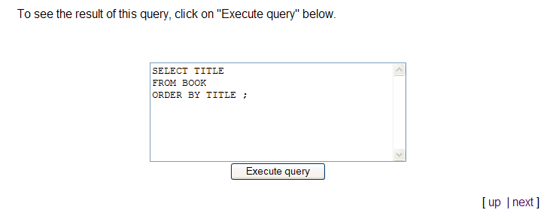

Slide 18

MySQL: open source RDBMS
Extensive documentation on MySQL website
Databases are built using SQL queries

Slide 19
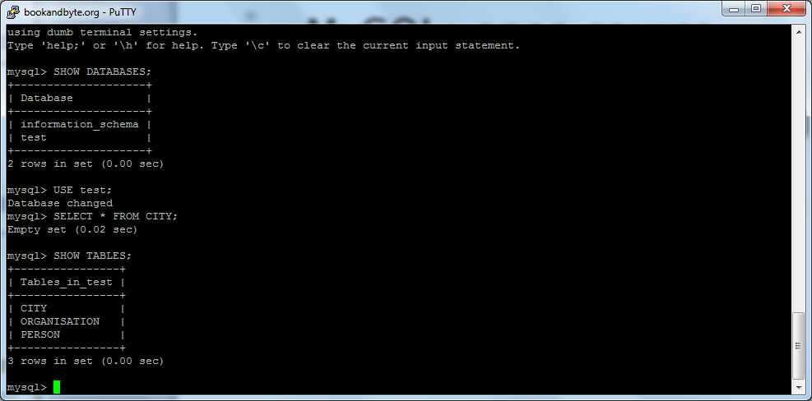
MySQL may be used via command prompt;
Databases can also be accessed, for instance, via PHP (PHPmyAdmin)

Slide 20
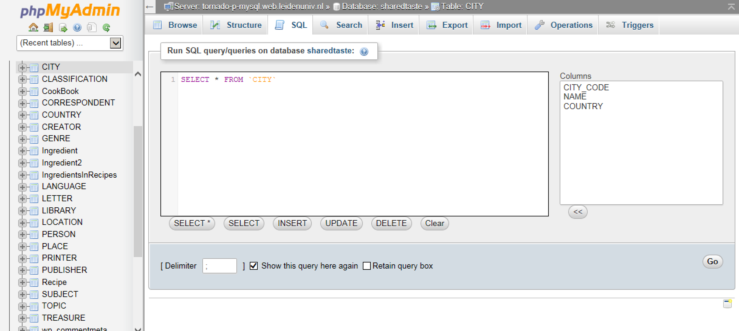

Slide 21
PHP: Hypertext Preprocessor
<html> <head> <title></title> </head> <body> <?php $time = date("h") ; if ( $time < 12 ) { print "Good morning!" ; } elsif ( $time < 18) { print "Good afternoon!" ; } else { print "Good evening!" ; } ?> </body> </html>

Slide 22
PHP
http
HTML
HTML
CLIENT
SERVER

Slide 23
PHP
http
HTML
db
HTML
MySQL
CLIENT
SERVER

Slide 24
Individual research project
Three raw datasets: https://digitalscholarship.nl/DMT/Assignments/ResearchProject.html
Define a research question
Develop a data model
Write a brief document (max. 300 words) in which you discuss your research question, and your ERD before 3 December

Slide 25
Today’s seminar
A second ’hackathon’
Based on the same data set
Implemented as a relational database
SQL to analyse the data and to make visualisations

Slide 26
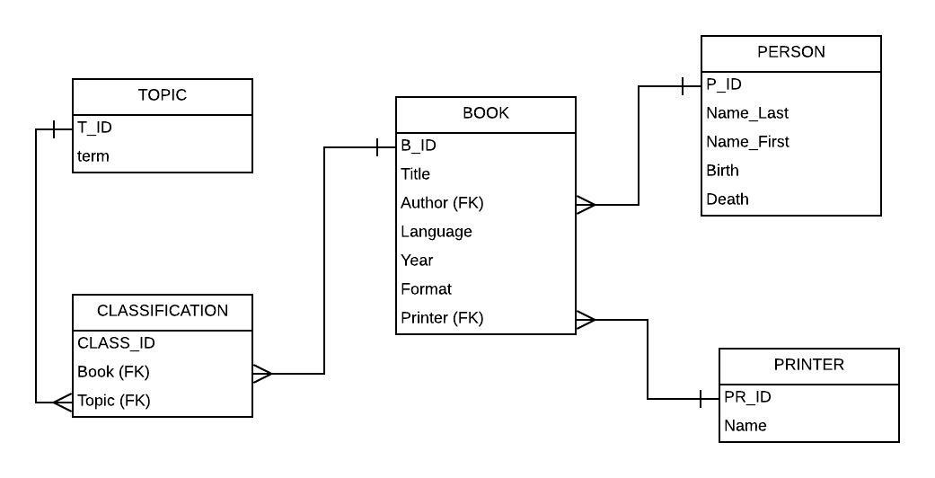

Slide 27

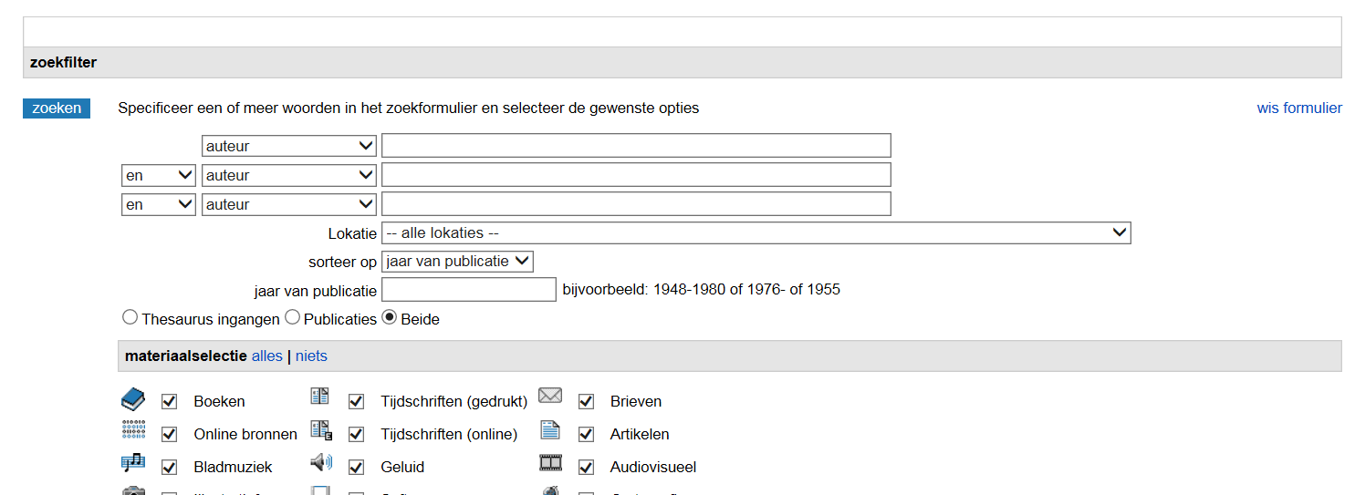

Slide 28
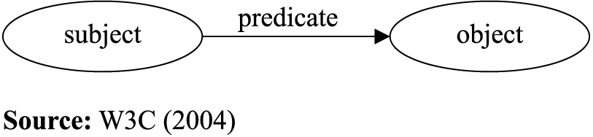
The Semantic web
Envisaged by Tim Berners-Lee as “a web of data that can be processed directly and indirectly by machines”
RDF-Triples

Slide 29
BOOK_ID | TITLE | ISBN13
1 | To Kill a Mockingbird | 9780446310789
2 | The Great Gatsby | 9781853260414
subject: “Book-ID” Predicate: “hasISBN13” Object: “9780446310789”
subject: “Book-ID” Predicate: “hasTitle” Object: “To Kill a Mockingbird”

Slide 30
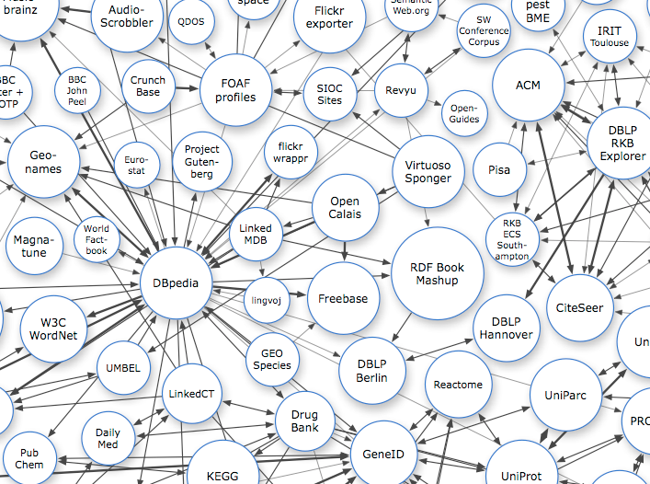
http://lod-cloud.net/

Slide 31
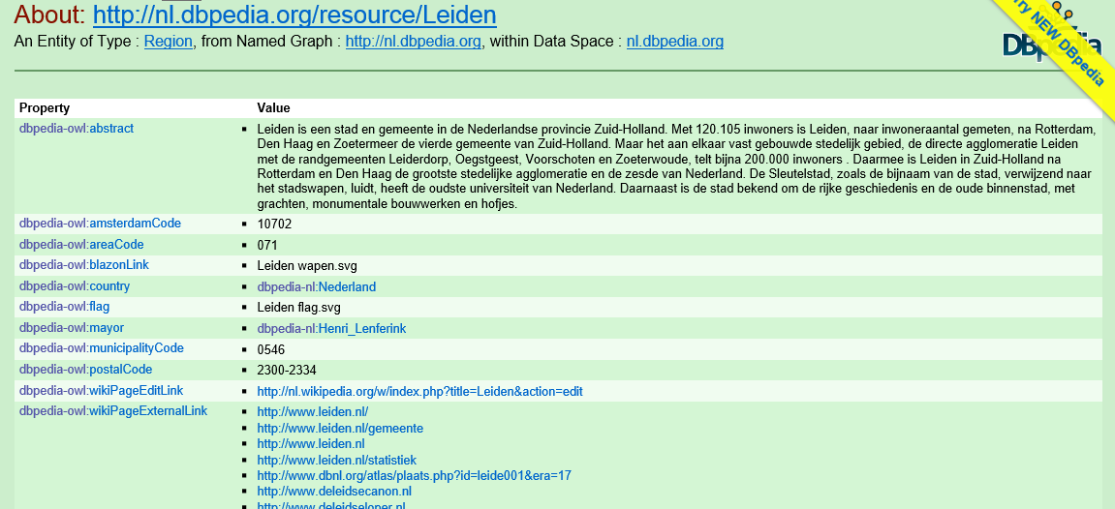
WikiData

Slide 32
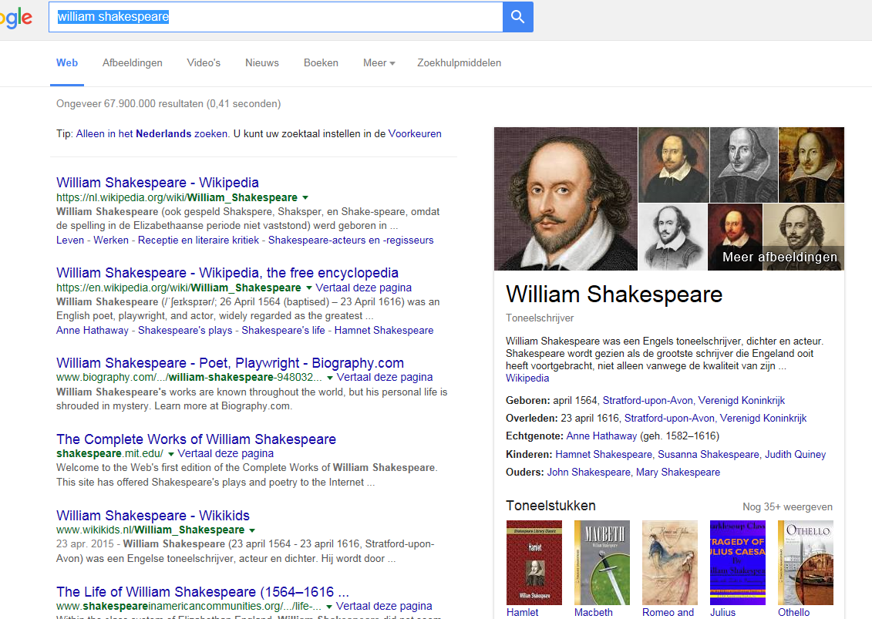

Slide 33
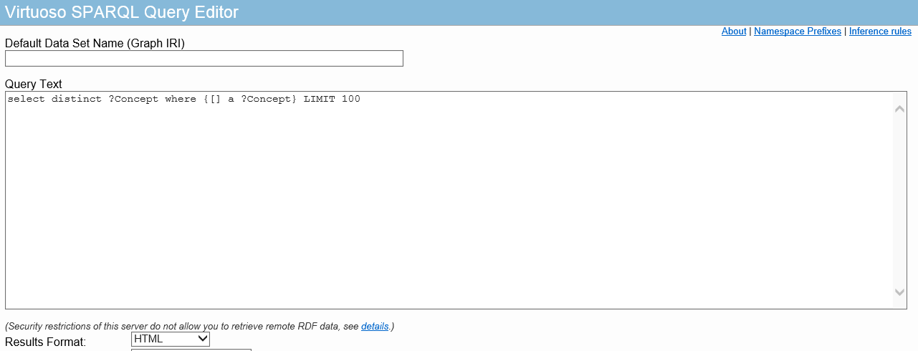
STCN SPARQL Endpoint
SELECT * WHERE {
<http://data.kb.nl/catalogus/101316577> dc:date ?d .
<http://data.kb.nl/catalogus/101316577> dc:title ?t .
}

